Slide 1
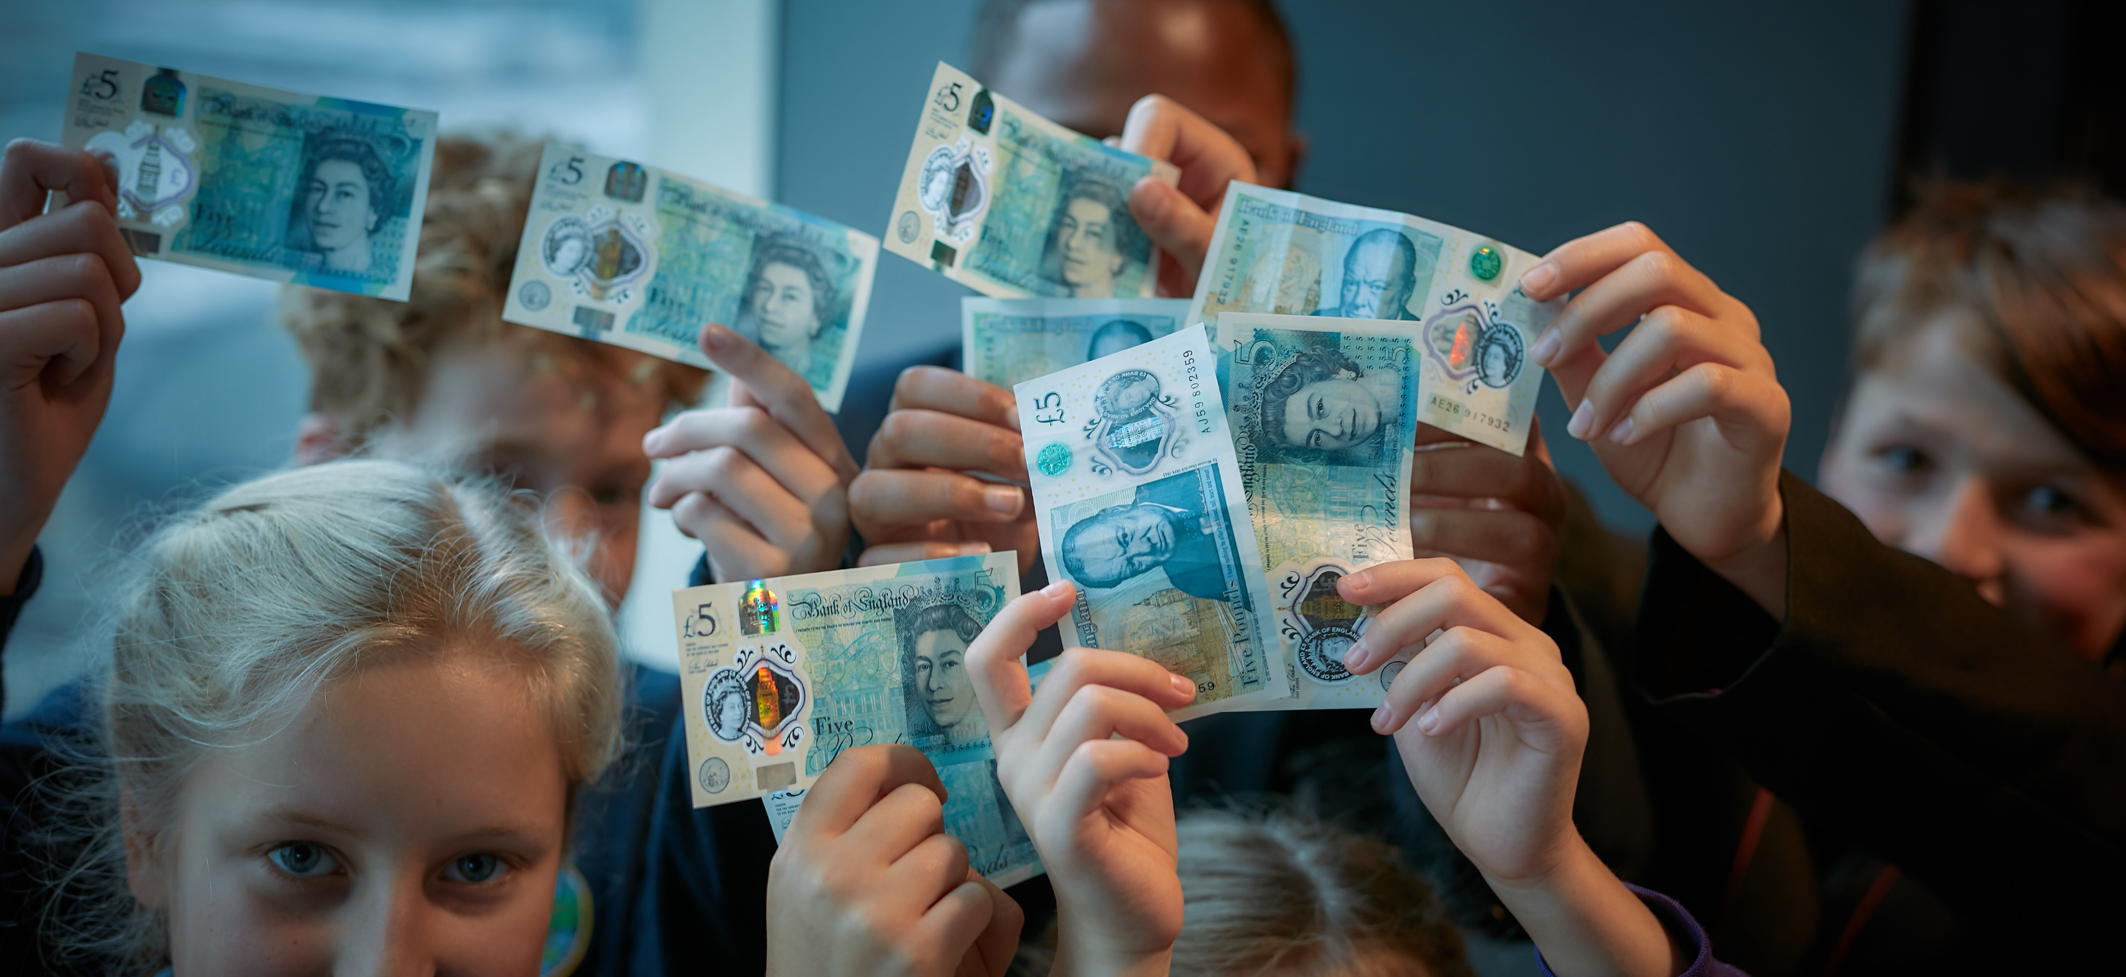

WEEK 2
Fiver Challenge
Notes:
Teacher Notes
Week 2:
This PowerPoint presentation provides…
A reminder of the tasks the pupils will need to think about and complete that week, together with a list of resources that will help them.
An activity that is linked to the tasks for that week to help them to succeed.
Note: Depending on how much time you have in advance of the challenge you may want to do some of the introductory activities earlier.

Slide 2

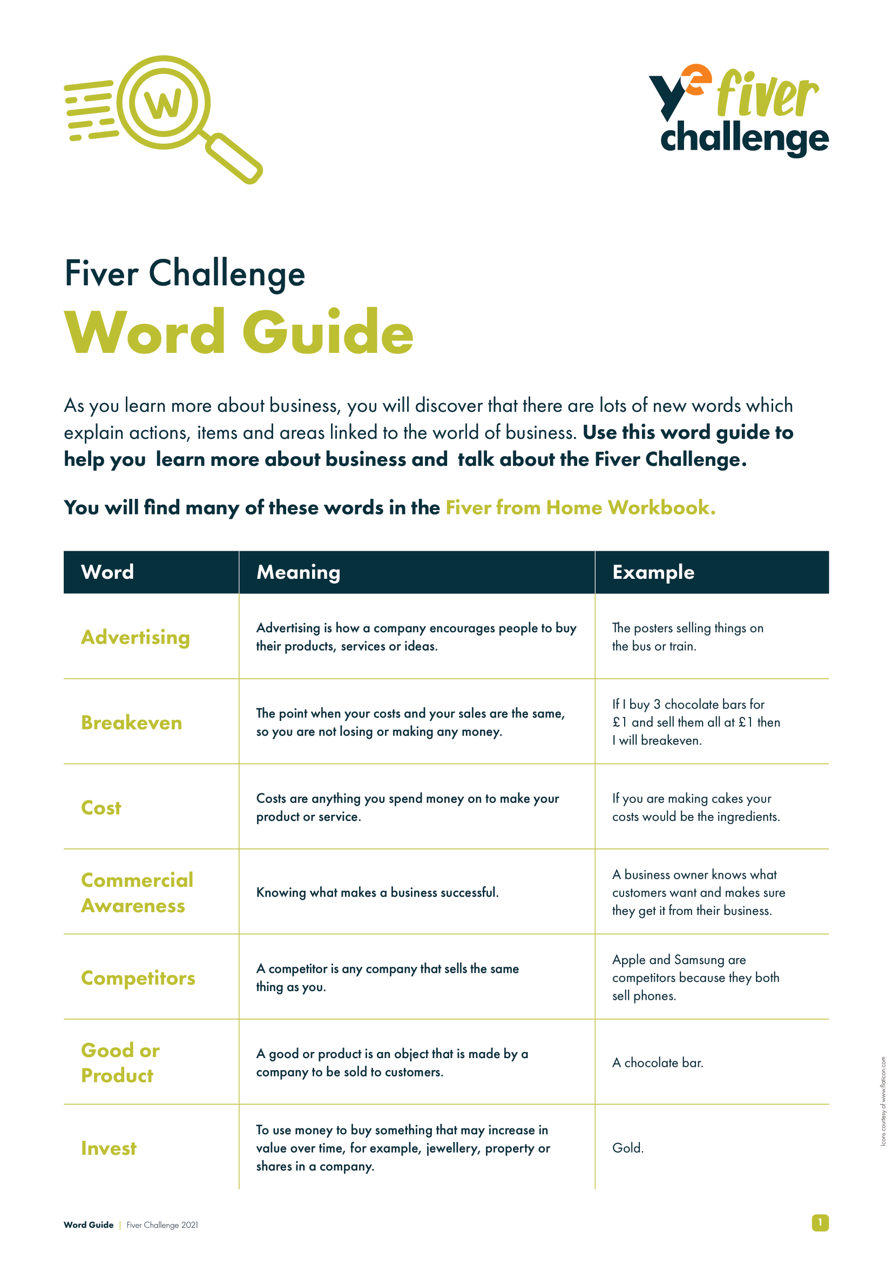

Word Guide
Revenue is the money you make by selling your product or service (e.g. if you sell a cake for £3, your revenue is £3).
Costs are anything you spend money on to make your product or service (e.g. if you are making cakes, your costs would be the ingredients).
Profit is the extra money you have left over from selling your product or service, once you have taken away your costs. In other words, your revenue minus your costs.
Think: What causes you to lose focus and concentration?
Notes:
Teacher Notes
Skills Builder Essential Skills
Listening - Step 5: I listen to others and record important information as I do
Listening is the skill of receiving, retaining and processing information. Encourage students to listen to key words from the definitions and write these down.
To incorporate the essential skill, ask the following reflective question when covering this slide:
What causes you to lose focus and concentration?
When working through their workbook, pupils will come across some important words/terms they need to know.
If they see a word or term they are unsure of they can use their Fiver Word Guide for the meaning.
Kick off week 2 with the three key terms (especially when creating their budget plan and shopping list).
Talk them through the meaning of revenue, cost and profit – this will help them complete the activity on the next slide.

Slide 3

Cost, Profit or Revenue?
Discuss the scenarios below. Try to identify which is an example of a cost, which is an example of revenue and which is an example of profit.
When setting up your jewellery business, you spent £3 on the materials to create your product. Is the £3 your cost, profit or revenue?
A: Cost
You made a total of £67 from selling tickets to your cricket tournament. Is the £67 your cost, profit or revenue?
A: Revenue
You spent £3 setting up your car wash business. After washing some cars, you made a total of £17. Once you subtract the £3 spent setting up your business, you are left with £14. Is this your cost, profit or revenue?
A: Profit
Think: How can you use this information for your
Fiver Business?
Notes:
Teacher Notes
Quick Activity (5 minutes)
Each of the three scenario’s appear on one mouse click. Discuss and figure out if it’s a cost, profit or revenue. Once you have allocated the term to each scenario click to show the correct answers.
If your pupils are unsure, you can explain what they are.
Skills Builder Essential Skills
Problem Solving - Step 3: I complete tasks by finding information I need myself.
Problem solving is the ability to find a solution to a situation or challenge. Talk to students about further information they might need to find out when thinking about their branding. Do they need further examples? Do they want to look at what similar products or services have done? Get them to think about where they might find that information.
To incorporate the essential skill, ask the following reflective question when covering this slide:
How can you use this information for your Fiver Business?

Slide 4

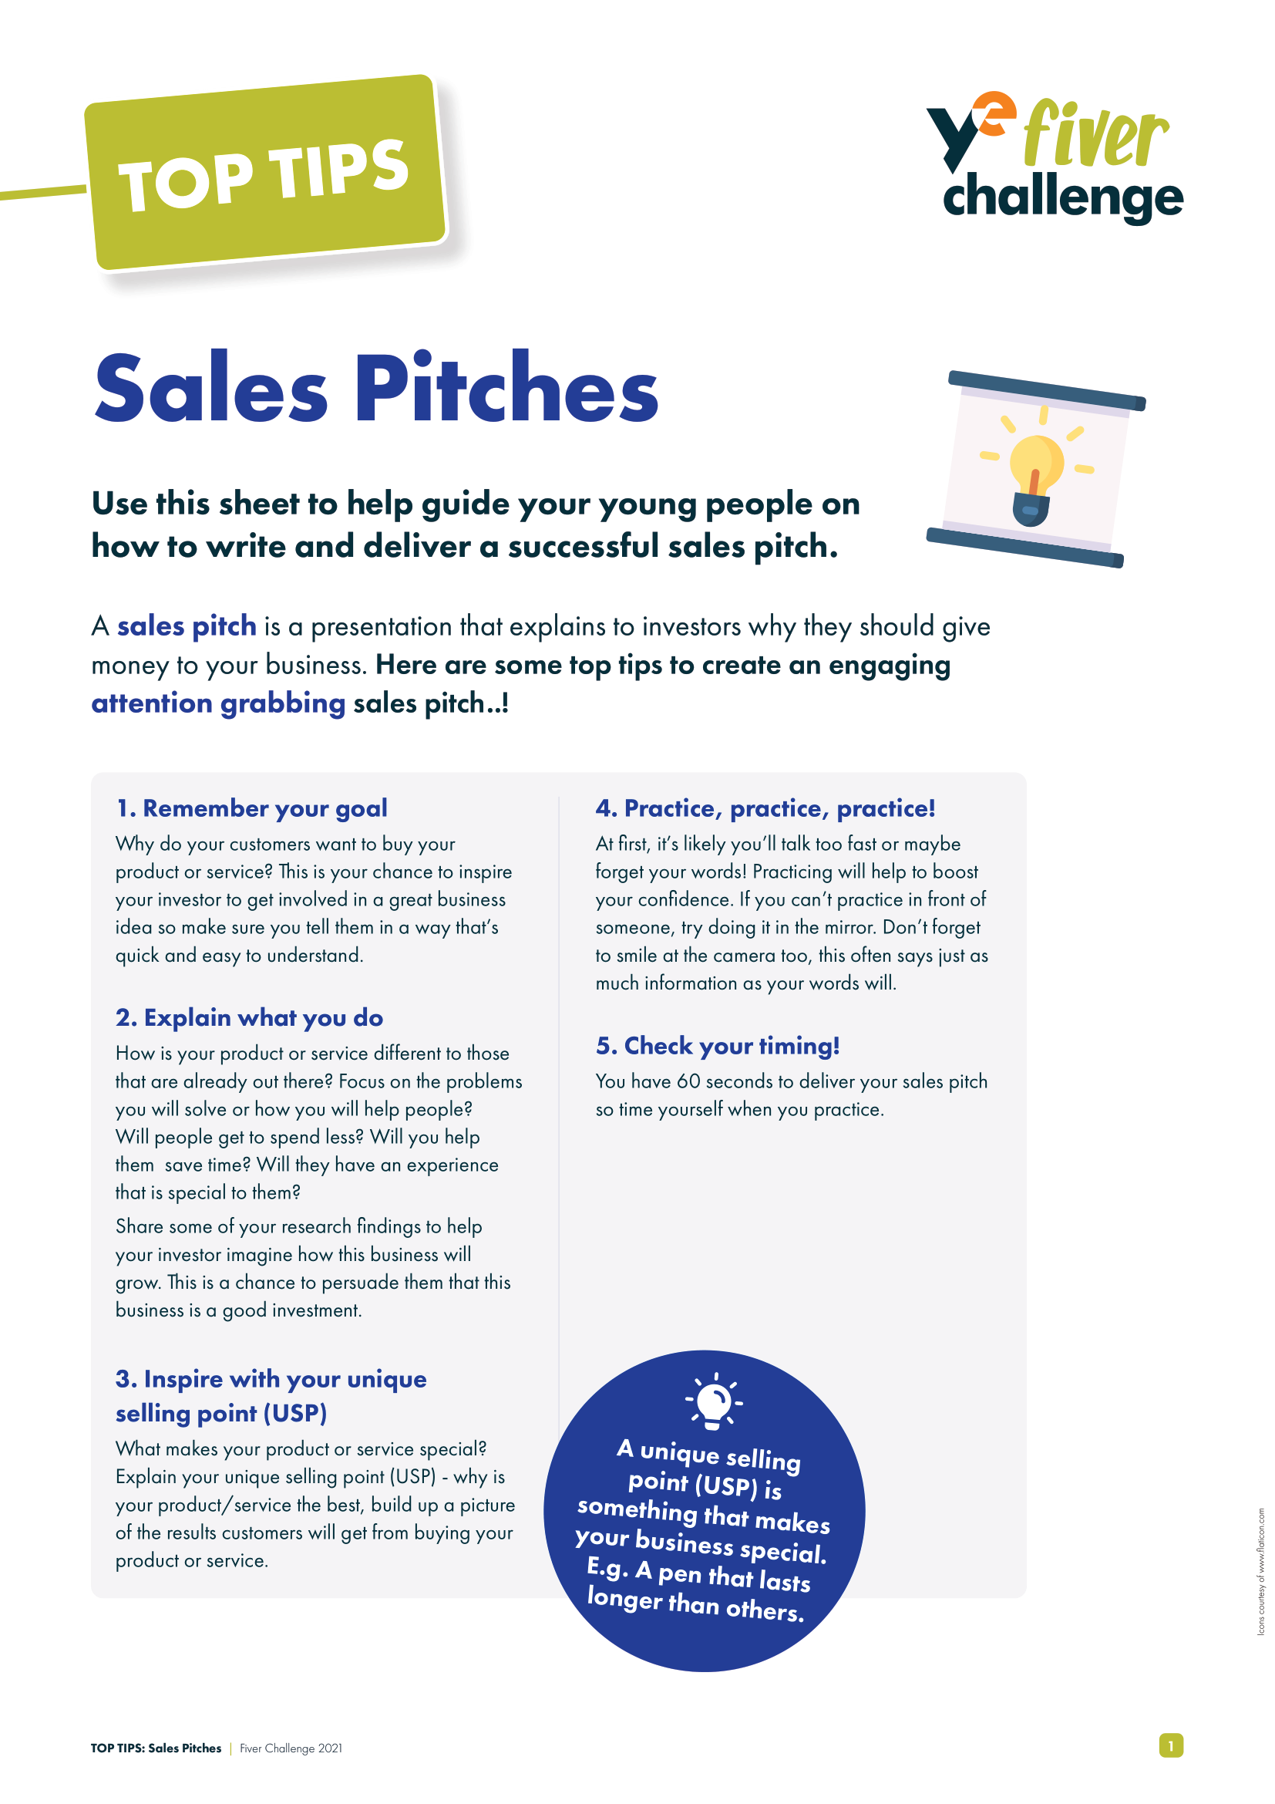

Getting Started!
You will need:
Fiver Challenge Workbook
Fiver Challenge Word Guide
Top Tips for Sales Pitches
Top Tips for Community Engagement
Notes:
Teacher Notes
This slide maps out what resources are available to pupils during Week 2.

Slide 5

Getting Started!
What you need to do:
Using your research results, gather the resources you will need for your product or service design.
Prepare your business plan.
Plan your budget and shopping list.
Prepare your sales pitch.
Prepare to enter the Sales Pitch Competition in Week 3!
Think: What does it mean to support other people?
Notes:
Teacher Notes
Following the available resources for Week 2, this slide maps out what specifically pupils will need to do during Week 2.
Skills Builder Essential Skills
Teamwork - Step 4: I work well with others by supporting them if I can do so
Teamwork is the skill of working cooperatively with others towards achieving a shared goal. Explain that across the challenge students will need to support each other and discuss what this might look like and why it is important. Students could identify situations for this week’s task where they think they will need to support others.
To incorporate the essential skill, ask the following reflective question when covering this slide:
What does it mean to support other people?

Slide 6

Your Business Plan
Using your Workbook to guide you, here are a few questions to consider when setting up your business:
Who can you approach for support?
Where will you find or buy your materials/resources?
How much will the cost? Can you negotiate?
What will it cost to deliver these materials?
How much time does it take to make your product?
Is your selling price flexible? Added value? Discounts for multibuy?
Discuss: How can we set a realistic challenge? When might we need additional information to solve a problem?
Notes:
Teacher Notes
Children will need to complete their business plan and begin to think about their budget. This will help them to plan their sales pitch and to enter the competition at the end of Week 3.
Skills Builder Essential Skills
Aiming High - Step 4: I work with a positive approach to new challenges
Aiming High is the ability to set clear, tangible goals and devise a robust route to achieving them. Explain to students that they will undoubtedly encounter challenges across the project but that it’s important to have a positive attitude to new challenges. Students could talk about why they think it is necessary to do this.
To incorporate the essential skill, ask the following reflective question when covering this slide:
How can we set a realistic challenge?
Problem Solving - Step 3: I complete tasks by finding information I need myself.
Problem solving is the ability to find a solution to a situation or challenge. Talk to students about further information they might need to find out when thinking about their branding. Do they need further examples? Do they want to look at what similar products or services have done? Get them to think about where they might find that information.
To incorporate the essential skill, ask the following reflective question when covering this slide:
When might we need additional information to solve a problem?

Slide 7
Your Budget and Shopping List
You have now selected the product or service you will be selling, and the next step is to plan your budget carefully to ensure you don’t run out of money. Consider…
The cost of the materials: will it be cheaper to bulk buy?
Where will you buy from that is both affordable and good quality?
Your budget: what is the total amount of £5 pledged between your team?
How much will it cost to make each product?
How much will each product be sold for?
How many products do you need sell to recover your costs?
Discuss: What can we learn from taking on new challenges?
Notes:
Teacher Notes
This slide reminds pupils to plan their budgets carefully, so they don’t overspend.
With the guidance of their Workbooks, they will need to calculate how much budget they have, and they will need to research and allocate how much they will spend on materials to create their product.
They will then need to workout how many products they need to sell to recover their expenditure costs.
Skills Builder Essential Skills
Aiming High - Step 4: I work with a positive approach to new challenges
To incorporate the essential skill, ask the following reflective question when covering this slide:
What can we learn from taking on new challenges?

Slide 8
Your Sales Pitch!
Imagine you’re on Dragons’ Den. How would you persuade the Dragons to invest in your business?
What’s your goal? What are the key features of your business?
What do you do? Introduce yourselves and describe your business.
What is your USP? What is your Unique Selling Point (USP)?
Timing? You mustn’t go over 60 seconds.
Body language? Act confident, smile! Engage with your audience.
Think: Why is it important to try to support other people?
Notes:
Teacher Notes
This slide will help pupils to prepare their sales pitches. How will they sell their business in just 60 seconds?
Skills Builder Essential Skills
Teamwork - Step 4: I work well with others by supporting them if I can do so
To incorporate the essential skill, ask the following reflective question when covering this slide:
Why is it important to try to support other people?

Slide 9
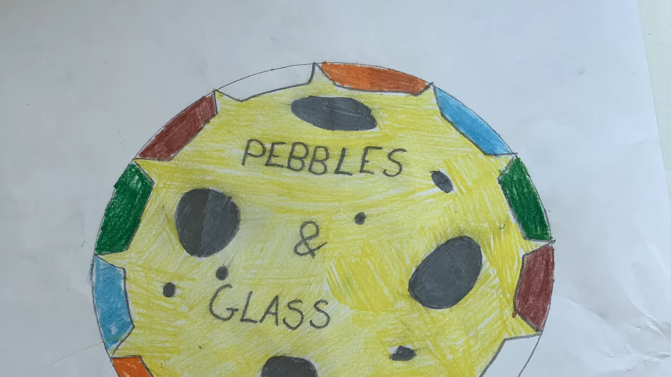

Best Sales Pitch 2023
Pebbles & Glass
Identify what information you think is most important. What are some things that you should include, and some things you shouldn’t?
Notes:
Teacher Notes
Show this sales pitch video to your pupils for inspiration and ask what they liked about it.
Skills Builder Essential Skills
Listening - Step 5: I listen to others and record important information as I do
To incorporate the essential skill, ask the following reflective question when covering this slide:
What do you think is the most important information?
Creativity - Step 3: I generate ideas when I've been given a clear brief
Creativity the use of imagination and the generation of new ideas. To help us to generate ideas we are sometimes provided with a brief. A brief is a problem or challenge that we have to come up with ideas to solve. The brief might be short or long; it might be in a written form, or it might be spoken.
To incorporate the essential skill, ask the following reflective question when covering this slide:
What are some things that you should include, and some things you shouldn’t?

Slide 10


Week 2 Recap
You have prepared your business plan.
You have made a list of the resource you’ll need for your product or service.
You have planned your budget and shopping list.
You have begun prepared your sales pitch for the competition in Week 3.
You have developed your essential skills.
Notes:
Teacher Notes
This slide reminds pupils of what they have achieved at the end of Week 2!

Slide 11


COMPLETE
Well done, you have completed Week 2!

